Slide 1
How To Write Unit Tests
Jason Sylvestre
College of Agricultural & Environmental Sciences
April 15, 2011

Slide 2
Writing Unit Tests Using UCDArch
1
2
Types Of Unit Tests
4
Helper Methods and Abstract Base Classes
Structure Of Unit Tests
5
Resharper Templates
3
File Structure Of Unit Tests
Notes:
Our tests are tightly bound to UCDArch
1) How to format the tests
2) Different types of tests (repository, controller, etc.)
3) How to name folders within the test project
4) Helper classes and Abstract Base classes I’ve created
5) Resharper templates For Generating Code

Slide 3
Structure Of Unit Tests
Notes:
Arrange, Act, and Assert

Slide 4
Structure Of Unit Tests
Arrange
Setup data specific to that test
Call Methods to setup common values
Mock and Fake
Act
Assert
Check for expected values
Check that specific mocked methods were called
Get and check parameters passed to mocked methods
Inconclusive check. Fails locally, but not on the builder.
Notes:
Arrange:
Setup Data, Remember some setup is done in the class constructor
Use methods to setup common data as much as possible. This makes the tests easier to read and fix.
Mock and Fake data
Act:
Where the method is called (The controller method, or ensure persistence, remove, etc.)
Assert:
True unit tests have only one assert per unit test, but I find that too restrictive.
Even the Unit Tests generated for the Account Controller in MVC3 assert more than 1 thing per test.
So…
Check for expected vales and the expected code is called
Check that expected parameters we passed to mocked methods (Ensure persistent for example)
Inconclusive fails locally, but not on builder. You can also use Ignore in the Test attribute.
I recommend that each of these sections be wrapped with a region identifying it.
If you use the resharper test runner, there is a link to go to the exact assert that failed.
If an Assert is not clear, it is a good idea to provide a message when the test fails. This is just a parameter.

Slide 5
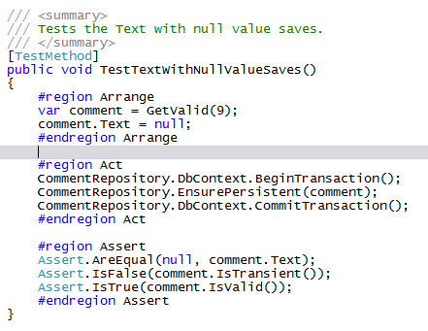
Sample of a simple unit test
Notes:
Repository test where a null value is allowed for a string
GetValid calls CreateValidEntity and then sets any required related entities
We save in the act
We check that the value we are testing was not changed and that the save took place

Slide 6
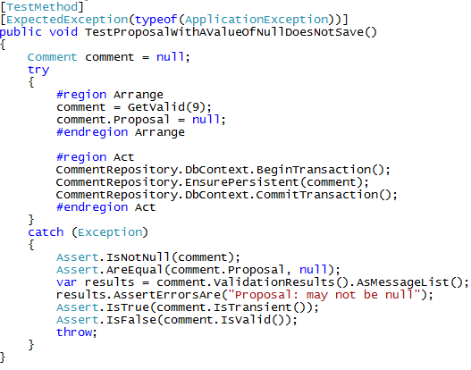
Sample of an Expected Exception
Notes:
This is the exception we would get if we tried to save this in a controller method even though it isn’t valid.
We want an exception. If we don’t get one this test fails.
We don’t want a different exception to be triggered.
Another way to do this is to set a bool outside the try-catch to false, set it to true just before we expect the exception, then assert in the catch that it is true
Proposal is a related table that has the [NotNull] attribute

Slide 7
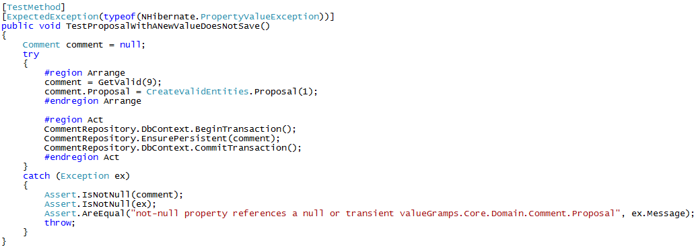
Another Expected Exception
Notes:
Here the proposal is not null, but it isn’t saved *BECAUSE* we don’t have the cascade set in the mapping.
If the mapping was changed to cascade save, this test would fail.

Slide 8
Types Of Unit Tests

Slide 9
Types Of Unit Tests
Repository Tests
Controller Tests
Interface Tests
Notes:
3 main types of tests.

Slide 10
Repository Tests
Test Database actions
Done on an in memory SQL Lite database created from the mapping file.
This is done by using UCDArch’s base class in testing “ FluentRepositoryTestBase”

Slide 11
Types of Repository Tests
CRUD Tests (if you use my base class and Resharper template, these are done with minimal coding)
Invalid Boundary Tests
Too Long, Too Short
Not Null
Required
Exceptions
Notes:
Types of tests:
CRUD – Create Read Update Delete. Some can’t because of mapping file setting like ReadOnly.
Note, if you don’t set required related tables, these tests will fail when it tries to initialize.
Invalid Boundary Test.
Just too long, just too short
Not Null
Etc.

Slide 12
Types of Repository Tests Cont.
Valid Boundary Tests
Maximum and minimum length
Null, empty, or spaces only when allowed
Constructor Tests
Fluent Mapping Tests
Reflection Tests
Ensure code coverage of tests
Notes:
Valid Boundary tests are the exact maximum, minimum, etc.
Constructor tests – just make sure that the expected values are set
(for example if you had several parameters, you may accidentally assign the parameter to a different field.)
Fluent Mapping tests. I’ll show an example in a bit
Reflection Tests.
Code Coverage, and attributes

Slide 13
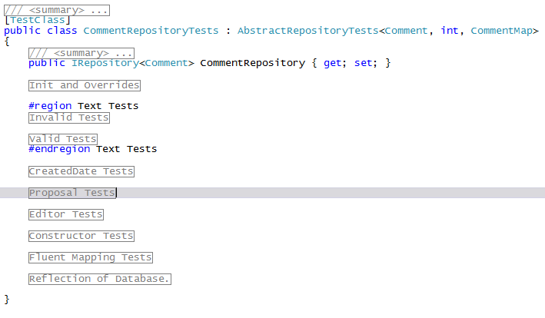
Example of Repository Test layout
Notes:
Part of this is generated when using my resharper file template
Group with regions
Initialize
Test each field
Test Constructor
Optionally do Fluent Mapping Tests
Do Reflection tests

Slide 14
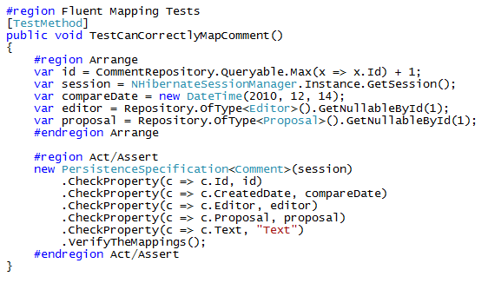
Fluent Mapping Example
Notes:
Fluent mapping is something new I started doing after finding an example on the net.

Slide 15
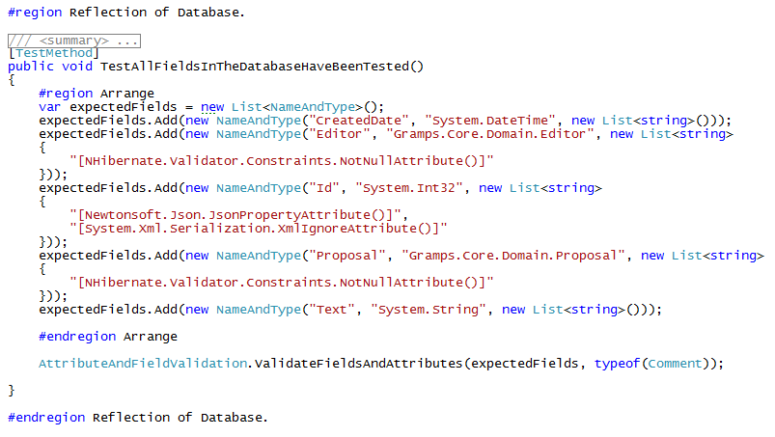
Reflection of the Database Example
Notes:
Use two helper methods “NameAndType” and “AttributeAndFieldValidation”
Each public field needs to be added.
If a field has attributes they need to be added.
If the Test fails, it tells you what it is expecting.
These are order dependent (sorted alphabetically). Sometimes the order of the attributes is different on Builder. I have a fix for this if it happens.

Slide 16
Controller Tests
Mapping Tests
Boundary Tests of all public methods
Reflection Tests
Notes:
I have a resharper template that sets up the initial structure of these tests and also provides some examples.
If all these tests suddenly fail, or fail when you first set them up, it is probably because there is Controller injection that needs to be mocked

Slide 17
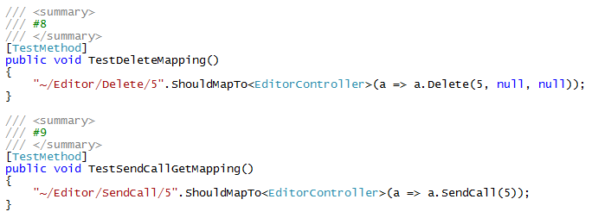
Mapping Tests
Notes:
If the only parameter is the id, these tests work fine.
If you have QueryString parameters, I have an overload in the helpers that can ignore the parameters.

Slide 18
Boundary Tests of all public methods
Sorry, no auto generated tests (But I do have helpers)
Setup the data (Fake)
Mock methods
Repository, Interfaced methods
Assert that they were or were not called
Check that the parameters passed were what was expected
Check that a view was rendered or was redirected
Check Controller Message and ModelState
Notes:
Each Controller method so far has been too different to create resharper templates for them.
There is a abstract base class helper to fake and mock in UCDArch.Testing
Doing boundary tests for controller methods gets uglier as the complexity of the method increases. Using interface methods reduces some of this complexity. Avoid static methods as much as possible as they can’t be mocked (not easily)
Any repository mocking is usually done in the class initialization.
Basically, any parameters passed to the controller’s class (injection) have to be mocked in the test init.
If possible, create a method to fake all the data you will need for all your tests, it really cleans up the arrange part of the tests.
If the controller is checking the CurrentUser’s identity this needs to be mocked. There is a methed in UCDArch.Testing to mock this as well as any files that may be returned.
Usually we test what is returned (redirect/view), error messages, and that expected code is executed.

Slide 19
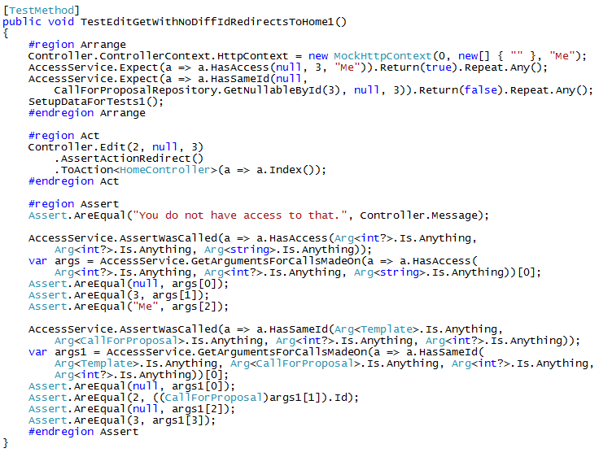
Example Of A Controller Method Test
Notes:
Yuck, I know. It can be worse which makes the test even more fragile.
HasSameId is mocked to return false, if HasAccess was mocked to return false, it would return the same way, but the “AssertWasCalled” for HasSameId would not have been reached.

Slide 20
Reflection Tests
Tests existence of attributes which are not called in the unit tests
Uses reflection
Ensures code coverage
I only add the method to this section once I have done Mapping and Boundary Tests
Two Main Areas
Controller Class
Controller Methods
Notes:
Controller Attributes are never run from unit tests
Reflection at least lets us know the attribute is there or not.
Similar to repository tests, I use these for code coverage as I have a count of the public methods.
I check the class attributes, then each method’s attributes too.
This is particularly important for Authorization attributes

Slide 21
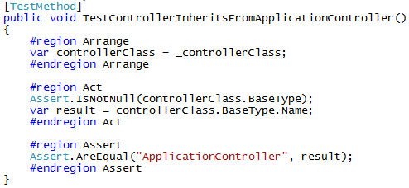
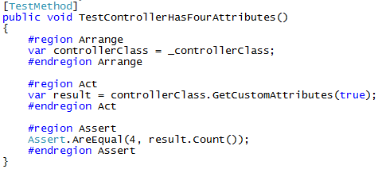
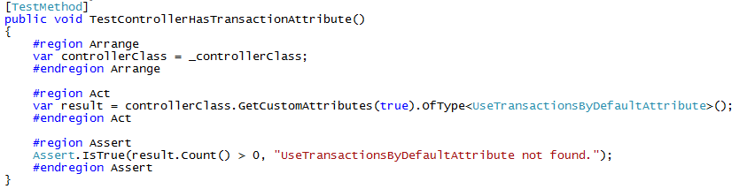
Controller Class Tests
Notes:
I check that the controller inherits from the expected base controller
I check that the controller has the expected number of attributes
my resharper template has a test for three, if you add any to your controller class, these tests need to be modified
For each of the 4 attributes found, I would have a test like the bottom one.

Slide 22
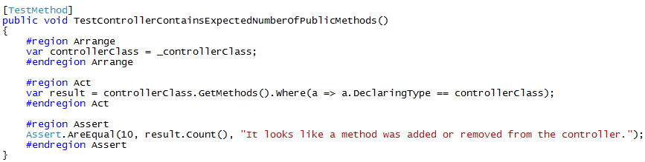
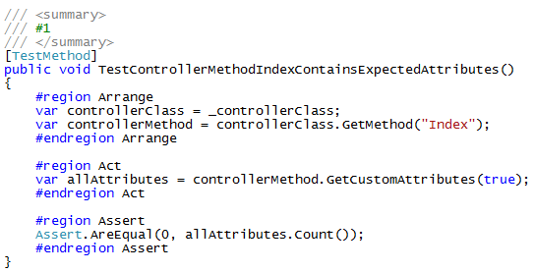
Controller Method Tests
Notes:
If you are working on a controller, you may not want the builder to keep showing up errors, you could add an Assert.Inconclusive(“some message”) You will get that the test failed, but not builder.
I like to have a number in the summary for these tests, and the mapping tests, that matches up to a number in the summary of the controller method.

Slide 23
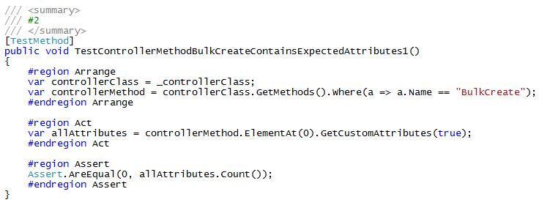
Controller Method Tests Cont.
Notes:
Create has both a Get and Post, so we need to use “ElementAt()” to identify which one we are looking at.

Slide 24
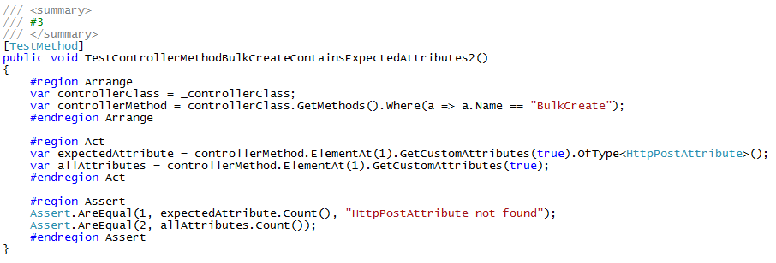
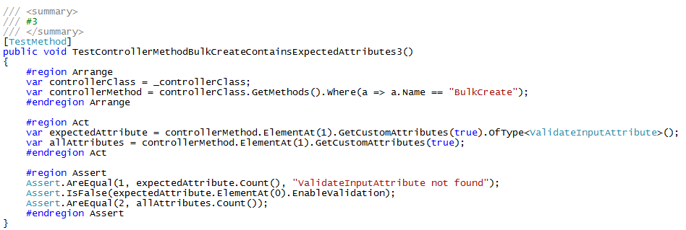
Controller Method Tests Cont.
Notes:
This post method has two attributes.
We can also assert values within the attribute

Slide 25
Interface Tests
Sometimes these need to be run within the structure of a Controller test
Check that expected parameters are passed
Check that any actions or return values are what is expected
Even if you don’t write tests for your interfaces, you just have one place to review the logic.
Notes:
If one of your interface methods sends an email, you probably don’t want to test it.

Slide 26
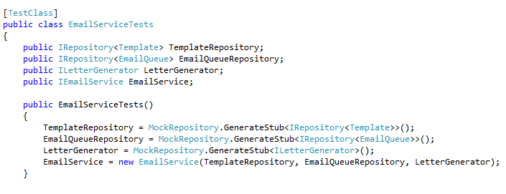
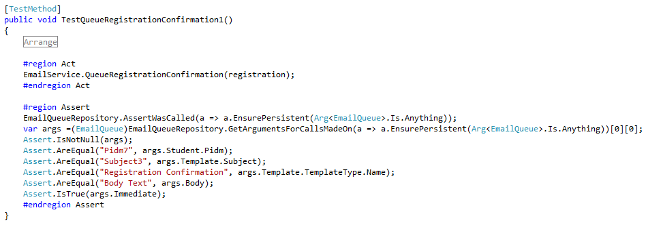
Interface Tests Example
Notes:
Top one is the constructor for the tests
Second one checks that the EmailQueue record was saved (once) with expected values

Slide 27
File Structure Of Unit Tests

Slide 28
File Structure Of Unit Tests
Project.Tests
ControllerTests
Core
InterfaceTests
MiscTests
RepositoryTests
ViewModelTests

Slide 29
ControllerTests
Controller1Tests (Partial Classes)
Controller1TestsInit.cs
Controller1TestsMapping.cs
Controller1TestsPart01.cs
Controller1TestsPart02.cs
Controller1TestsReflection.cs
Controller2Tests.cs
Notes:
Controller tests often get very long which causes resharper to slow down. I like to break these into partial classes.

Slide 30
Core
Extensions
AssertExtensions.cs
RouteTestingExtensions.cs
StringExtensions.cs
Helpers
AttributeAndFieldValidation.cs
ControllerRecordFakes.cs
CreateValidEntities.cs
NameAndType.cs
SpecificGuid.cs
AbstractRepositoryTests.cs (until moved to UCDArch)
Notes:
You will probably need to edit CreateValidEntites and ControllerRecordFakes as you write tests.

Slide 31
Interface Tests
<InterfaceName>Tests.cs
Notes:
If you have any.

Slide 32
Misc Tests
Test that Role Attributes work as expected.
Other Tests that don’t really fall in other categories

Slide 33
RepositoryTests
SmallRepository1Tests.cs
LargeRepository2Tests (partial Classes)
LargeRepository2TestsInit.cs
LargeRepository2TestsConstructor.cs
LargeRepository2TestsFluentMapping.cs
LargeRepository2TestsPart01.cs
LargeRepository2TestsPart02.cs
LargeRepository2TestsReflection.cs

Slide 34
ViewModel Tests
I’d suggest only having ViewModel Tests if the logic is particularly convoluted.
These tests can usually be integrated into the controller tests

Slide 35
Helper Methods

Slide 36
Helper Methods
UCDArch.Testing. More may be moved there
ControllerRecordFakes.cs
FakeHttpPostedFileBase.cs
FakeIdentityAndFiles.cs
AttributeAndFieldValidation.cs
CreateValidEntities.cs
NameAndType.cs
SpecificGuid.cs
Notes:
ControllerRecordFakes is an abstract base class that makes it a lot easier to fake data for Controller tests. It fakes, GetNullableById, Queryable, and GetAll
CreateValidEntities is where you would create a static method for each of your tables, and populate the required fields. String fields I always populate as The FieldName + counter if the counter is not null. This ties in with my Repository abstract base class methods.
If you have Guid as the Id, SpecificGuid lets you set your test data to reproducible values.

Slide 37
Resharper Templates

Slide 38
Resharper Templates
Generate Files or Code, prompting values to be replaced
My templates start with Jason so I can find them easily. If you use mine, feel free to rename or edit them.
Two main Types of Templates
FileTemplates
LiveTemplates

Slide 39
File Templates
JasonControllerTest
Creates a simple file with examples for Controller tests
JasonRepositoryTest
Creates a repository test file using the Abstract base class
Initializes data, does CRUD tests.

Slide 40
Live Templates
JasonBoolTests
Creates two tests, code for reflection in comment
JasonCheckRequire
Single Test with expected Exception
JasonDateTests
Three Tests, past current, future. No Nullable. Code for Reflection
Evict
Code to evict entity.
JasonGetArguments
Code to get the arguments for Repository Entity EnsurePersistent. Needs tweeking.
JasonStringTests / JasonStringTestsLengthOnly
A bunch of string tests. Needs a little tweeking sometimes. Code for Reflection

Slide 41
Summary
This is the basic structure for Unit Tests that I have been using.
It continues to evolve.
If you come up with other ways to get better coverage, less fragile tests, or other improvements please share.

Slide 42
Resources
The Art of Unit Testing http://artofunittesting.com/
This slide deck and related resources: https://github.com/jSylvestre/ResharperTemplates

Slide 43
Questions?

